Slide 1
A Complete Guideline
Course Code: CSC 2108
Course Title: Introduction To Database
Department of Computer Science
Faculty of Science and Technology
Lecture No: | 01 | Week No: | 01 | Semester: | Summer 23-24
Lecturer: | Nazia Alfaz, nazia@aiub.edu, Office Room: D0201B

Slide 2
Lecture Outline
American International University-Bangladesh (AIUB)
Computer Science(CS) Department of AIUB
Necessary Policies and Rules
Outcome Based Education (OBE)
Basic Information Regarding this Course
Database Terminology

Slide 3
American International University- Bangladesh (AIUB)
Vision of AIUB
AMERICAN INTERNATIONAL UNIVERSITY-BANGLADESH (AIUB) envisions promoting professionals and excellent leadership catering to the technological progress and development needs of the country.

Slide 4
American International University- Bangladesh (AIUB)
Mission of AIUB
AMERICAN INTERNATIONAL UNIVERSITY-BANGLADESH (AIUB) is committed to provide quality and excellent computer-based academic programs responsive to the emerging challenges of the time. It is dedicated to nurture and produce competent world class professional imbued with strong sense of ethical values ready to face the competitive world of arts, business, science, social science and technology.

Slide 5
Computer Science(CS) Department of AIUB
Vision of CS Department
Our vision is to be the preeminent Department of Computer Science through creating recognized professionals who will provide innovative solutions by leveraging contemporary research methods and development techniques of computing that is in line with the national and global context.

Slide 6
Computer Science(CS) Department of AIUB
Mission of CS Department
The mission of the Department of Computer Science of AIUB is to educate students in a student-centric dynamic learning environment; to provide advanced facilities for conducting innovative research and development to meet the challenges of the modern era of computing, and to motivate them towards a life-long learning process.

Slide 7
Necessary Policies and Rules
General University Rules
Entering the University without ID card is strictly prohibited
No students will be allowed to sit in the class/exams without student ID card
Keep your campus clean

Slide 8
Necessary Policies and Rules
Classroom/ Laboratory Policy
Please keep silent during lecture time
There will be session for questioning after completing each topic/subtopic/chapter
Please ask your personal question in break /after finishing lecture/ consulting hours
If some of you already know the materials I am discussing, give chance to other students to understand the matter
Break will be given during class. However you are strictly advised to follow proper protocols during the break time also. Remember break time is not for roaming around the halls or creating ruckus in the class/lab rooms. Even during break time you are a student so behave like a student.
You are encouraged to take notes of the lecture in your notebook if deemed necessary
Using smart phones/cameras to click photos during class is strictly prohibited.
You are specially prohibited to take snapshots of the classroom whiteboard.
Try to keep your smart phones/ mobile phones in your bag/pocket/purse during class hours
Make sure to log out of any personal account i.e. AIUB Student Portal/email account on the Lab PC that you are using once your allocated lab hours is over.

Slide 9
Outcome Based Education (OBE)
Significance
Outcome Based Education
OBE is an educational process
Directed/focused at achieving certain specified outcomes in terms of individual student learning
Outcomes - key things students should understand and be able to do or the qualities they should develop

Slide 10
Basic Information Regarding This Course
COURSE CODE:CSC 2108
COURSE NAME:
INTRODUCTION TO DATABASE
COURSE TEACHER:Nazia Alfaz

Slide 11
Basic Information Regarding This Course
Class Hours
Theory class- Three(3) hours
Lab class- Four(4) hours

Slide 12
Basic Information Regarding This Course
Course Objective
To be able to:
Identify the drawbacks of file-based management system and the necessity of Database management system
Use modern tools utilized in Database management system.
Understand different types of terminologies used in Database management system
Discuss different tools and techniques for better performance of Database management system
Execute necessary and sufficient SQLs
Design ER Models and Diagrams
Use different types of Normalization process
Analyze a system with a view to DBMS implementation
Understand different types of joining and use of different complex queries

Slide 13
Database Terminology
Data, Information, Knowledge and Wisdom
Data: Raw, unprocessed facts and figures that on their own have no meaning
  Example: Mymensingh, 3.91, 23-53081-3
Information: Data that has been processed within a context to give it meaning.
Example:
  The hometown of Rahad is Mymensingh.
  The CGPA of SHREYA is 3.91.
  The student ID of IMRAN is 23-53081-3.

Slide 14
Database Terminology
Data, Information, Knowledge and Wisdom
  Knowledge-The capability of understanding the relationship between pieces of information and what to actually do with the information.
  Wisdom-the ability to make well-informed decisions and take effective action based on understanding of the underlying knowledge.

Slide 15
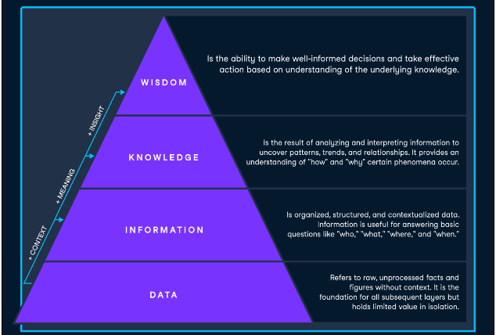
Database Terminology
The Knowledge Pyramid
The Data-Information-Knowledge-Wisdom (DIKW) pyramid illustrates the progression of raw data to valuable insights.

Slide 16
Database Terminology
Example: Fitness tracking
Fitness tracking devices collect your health and activity data, but your end goal is to use that to make decisions about how to train or how to manage your health.
Data: The smartwatch collects raw data such as the number of steps taken, heart rate, and sleep duration.
Information: The smartwatch app organizes and structures the data, displaying it in a comprehensible format, such as daily step count, average heart rate, and hours of sleep per night.
Knowledge: Analyzing and interpreting the information may reveal patterns, such as increased step count leading to improved sleep quality or a correlation between heart rate and workout intensity.
Wisdom: Understanding these patterns lets you make informed decisions about adjusting your exercise routine, sleep habits, and other lifestyle factors to improve your health and fitness.

Slide 17
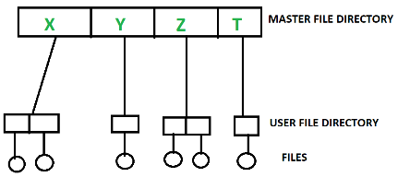
Data Management System
File System
The file system is basically a way of arranging the files in a storage medium like a hard disk. The file system organizes the files and helps in the retrieval of files when they are required. File systems consist of different files which are grouped into directories. The directories further contain other folders and files. The file system performs basic operations like management, file naming, giving access rules, etc.

Slide 18
Data Management System
Drawbacks of File System
Location: The user should be aware of the location to access the data.
Data Hiding/Data Privacy: It is difficult to hide data in file system and can result data redundancy.
Data Redundancy: Data Redundancy means duplicate data and it is also stated that the same parts of data exist in multiple files. This condition is known as Data Redundancy.
Data Inconsistency: Data inconsistency is the lack of standardization and uniformity in data across different files. This results in different data files containing conflicting, inaccurate, or incomplete information about the same entity or attribute.

Slide 19
Database Terminology
Database
A database is an organized collection of structured information, or data, typically stored electronically in a computer system. It has collection of related data that represent some real world entities. A database is usually controlled by a database management system (DBMS). Together, the data and the DBMS, along with the applications that are associated with them, are referred to as a database system, often shortened to just database.
Example: University Management System, Library Management System

Slide 20
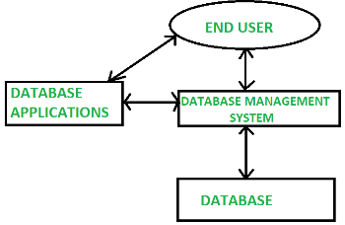
Database Terminology
Database Management System
A Database Management System (DBMS) is a software system that is designed to manage and organize data in a structured manner. It allows users to create, modify, and query a database, as well as manage the security and access controls for that database.
DBMS provides an environment to store and retrieve the data in coinvent and efficient manner.

Slide 21
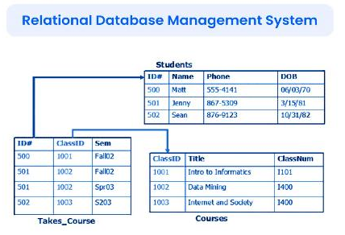
Database Terminology
Relational Database Management System (RDBMS)
RDBMS: Data is organized in the form of tables and each table has a set of rows and columns. The data are related to each other through primary and foreign keys

Slide 22
Database Terminology
Oracle Database
A Relational Database Management System (RDBMS) produced and marketed by Oracle Corporation.
Oracle 10g
Database Schema Scott
Tables: DEPT, EMP, BONUS and SALGRADE

Slide 23
Database Terminology
SQL
SQL stands for Structured Query Language
SQL is used to communicate with a database
According to American National Standard Institute (ANSI), it is standard language for Relational Database Management System (RDBMS)
SQL can execute queries against a Database.
Synonyms of query-> to ask, questioning ,to inquire etc.

Slide 24
Books
Modern Database Management (Sixth Edition) by Fred R. McFadden, Jeffrey A. Hoffer, Mary B. Prescott
Database System Concepts (Fifth Edition) by Henry F. Korth, S. Sudarshan, A. Silberschatz
Oracle-database-10g-sql-fundamentals-1-student-guide-volume-1
SQL and Relational Theory: How to Write Accurate SQL Code by C.J. Date
Database Systems: A Practical Approach to Design, Implementation and Management (4th Edition) by Thomas M. Connolly, Carolyn E. Begg
Fundamentals of Database Systems, 5th Edition by RamezElmasri, Shamkant B. Navathe
Database Design and Relational Theory: Normal Forms and All That Jazz by C. J. Date
An Introduction to Database Systems 8th Edition, by C.J. Date

Slide 25
References
https://www.db-book.com/db6/slide-dir/index.html
https://docs.oracle.com/en/database/oracle/oracle-database/20/sqlrf/SQL-Standards.html#GUID-BCCCFF75-D2A4-43AD-8CAF-C3C97D92AC63
https://www.slideshare.net/HaaMeemMohiyuddin1/data-knowledge-and-information
https://www.slideshare.net/tabinhasan/from-data-to-wisdom
https://www.slideshare.net/thinnaphat.bo/

